Slide 1
Mini Project
Manoj Velu
Hussain Kaide Johar Manasi
Naveen Seelam
Fall 2023 December 4, 2023

Slide 2
Dataset Info

Slide 3
Initial Data - (7752, 25)
Removing Null Values (7588, 25)
Training Set (4553, 25) – 60%
Validation Set (1517, 25) – 20%
Testing Set (1518, 25) – 20%
Notes:
Charanya

Slide 4
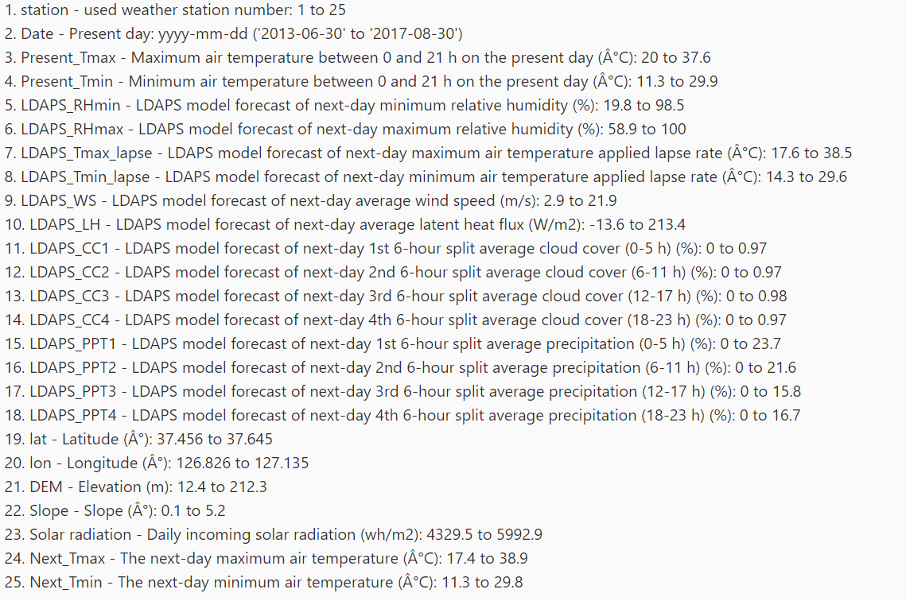
Data Dictionary

Slide 5
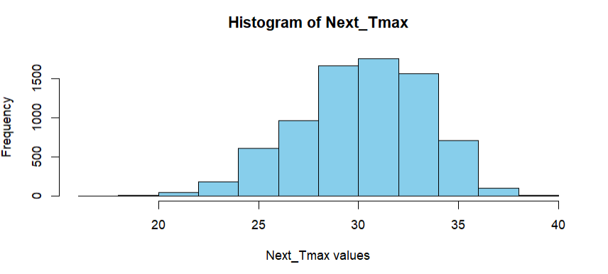
Response Variable Distribution

Slide 6
Initial Model

Slide 7
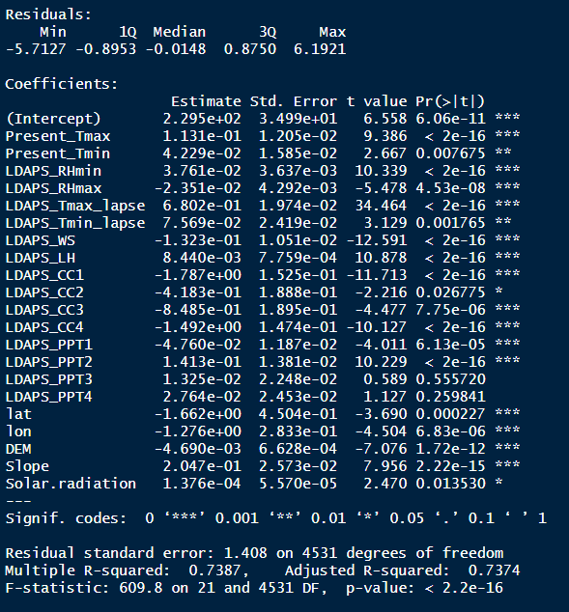
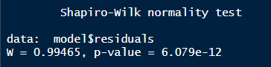
Results for Initial Model

Slide 8
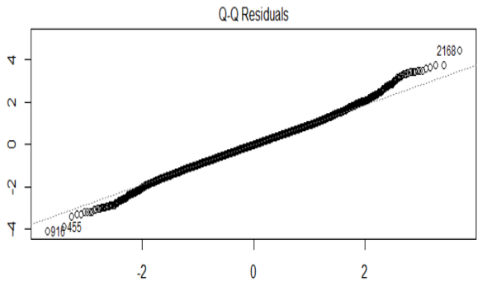
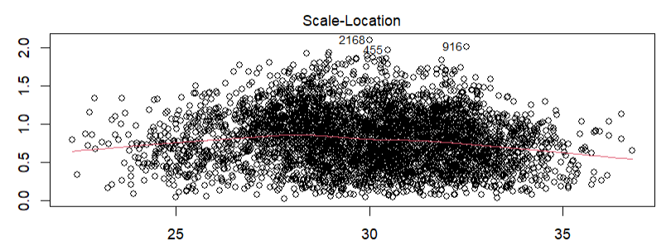

Slide 9
Improved Model

Slide 10
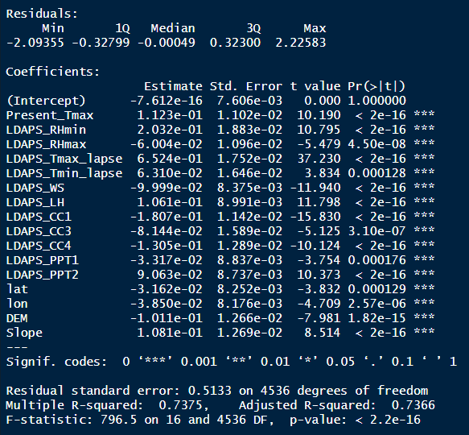
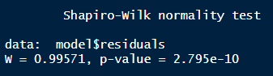
Results for Improved Model

Slide 11
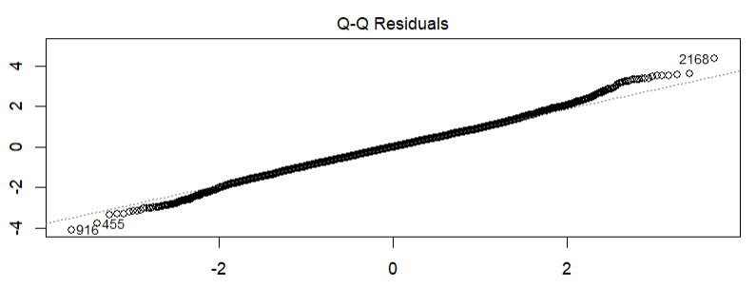
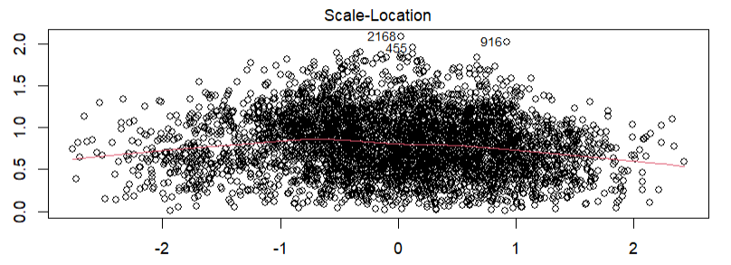

Slide 12
Results
Model | RMSE_Validation | RMSE_Test | Adjusted R^2
Initial | 1.513 | 1.647 | 0.7374
Improved | 0.406 | 0.499 | 0.7366

Slide 13
Questions

Slide 14
Thank You!

